Slide 2
1 + 1 = ?

Slide 3
1 + 1 = 3

Slide 4

+ = 3

Slide 5
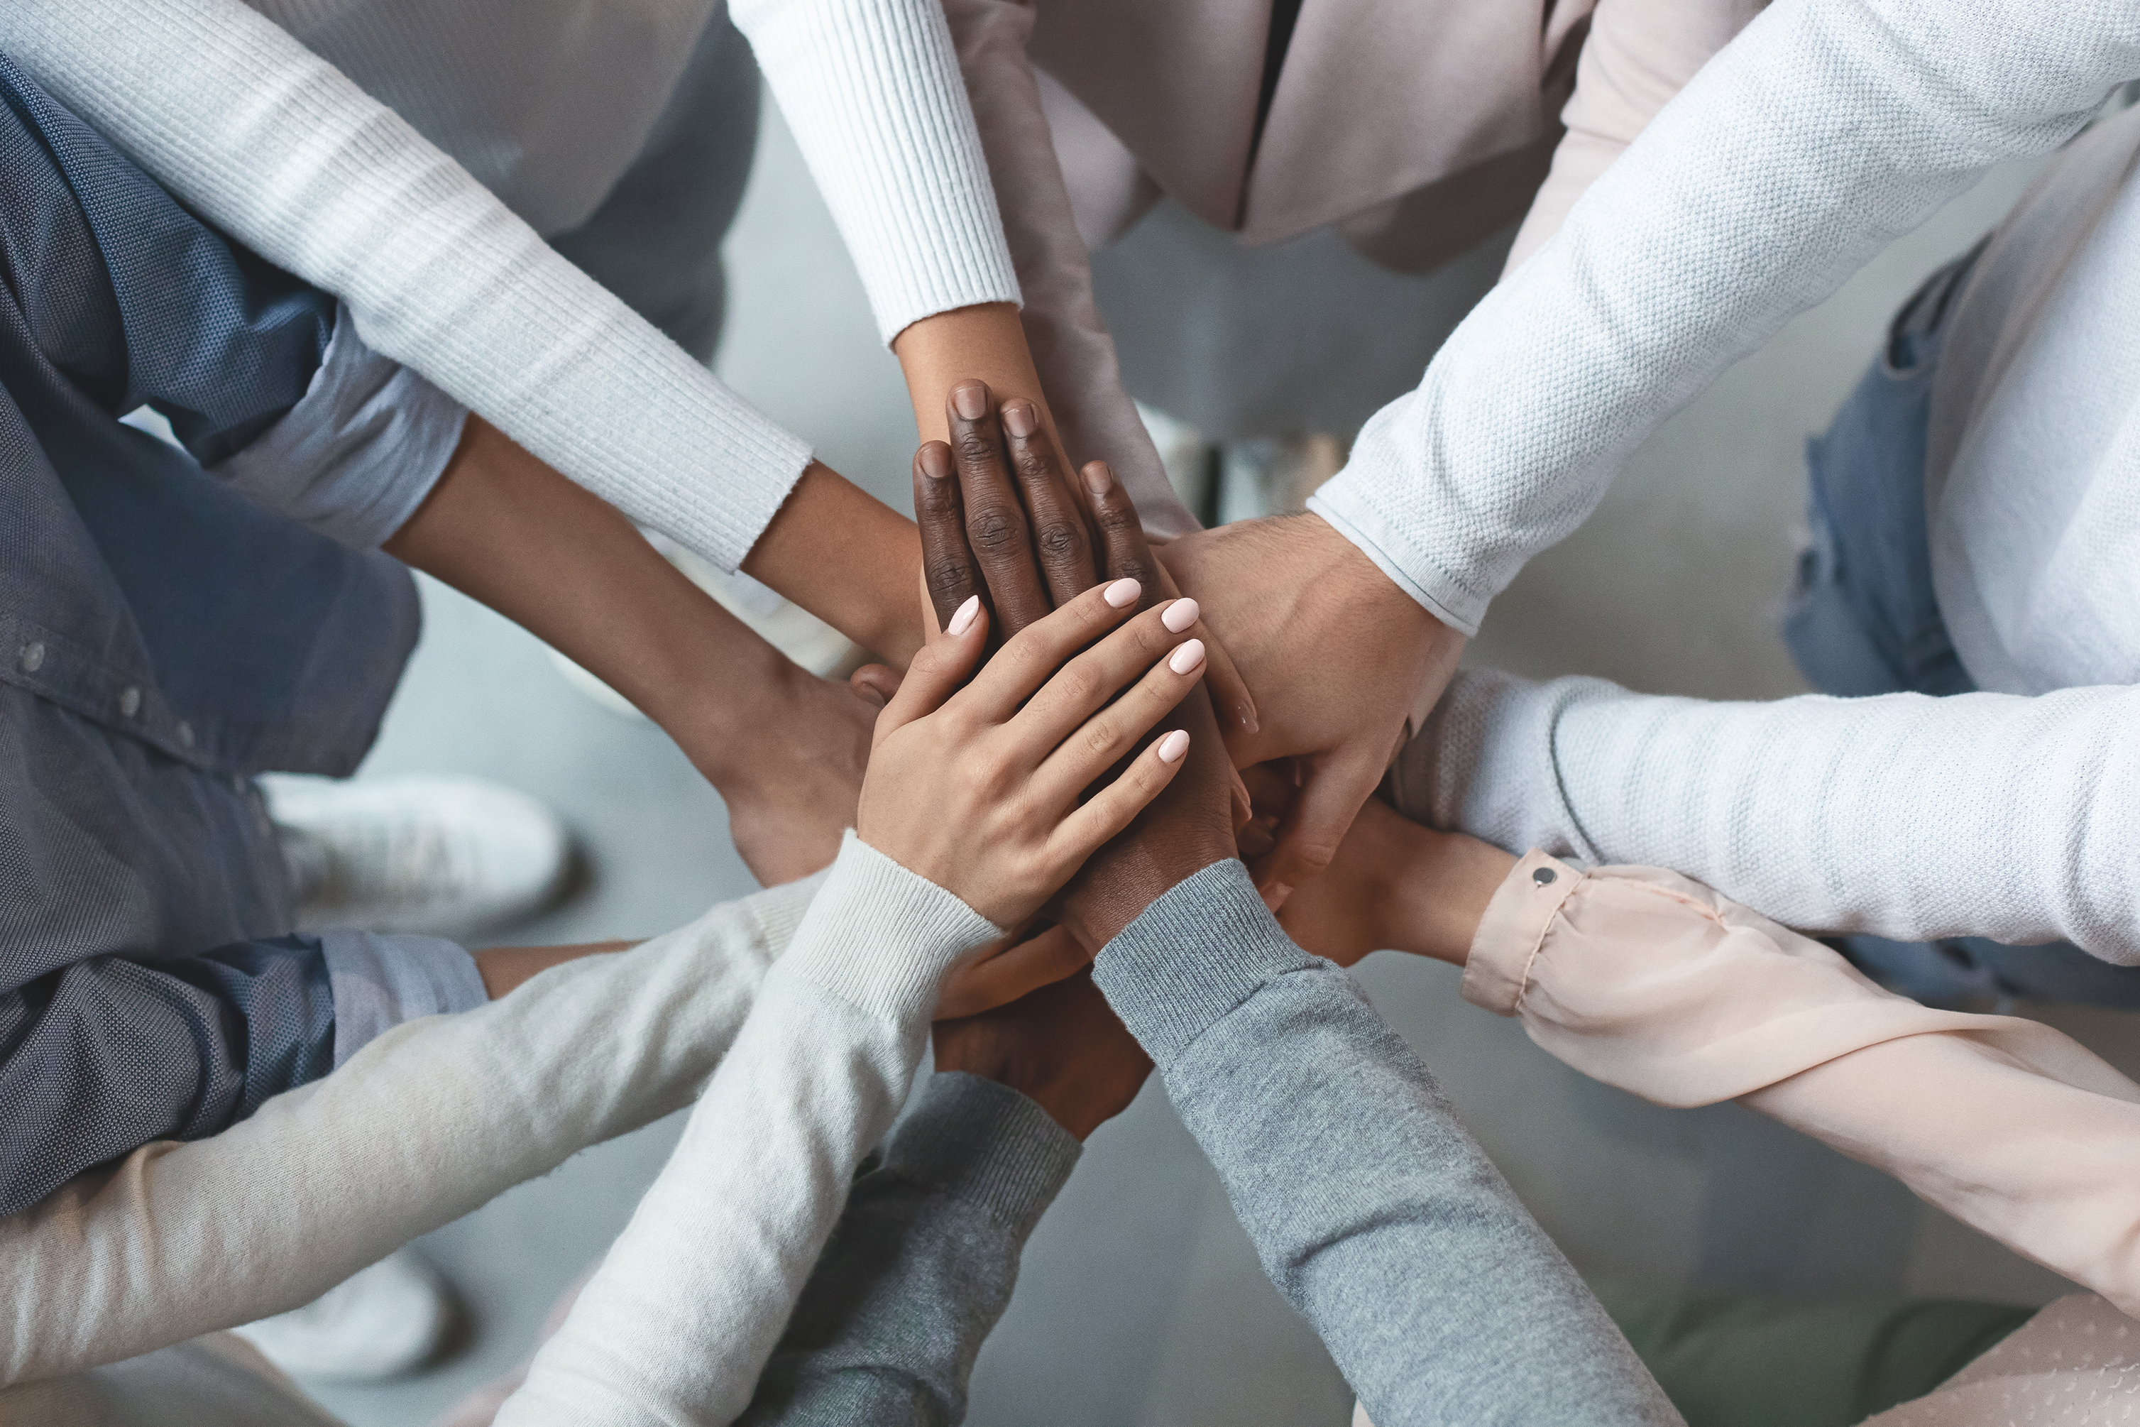
1+1=3
Person +person = more output

Slide 6
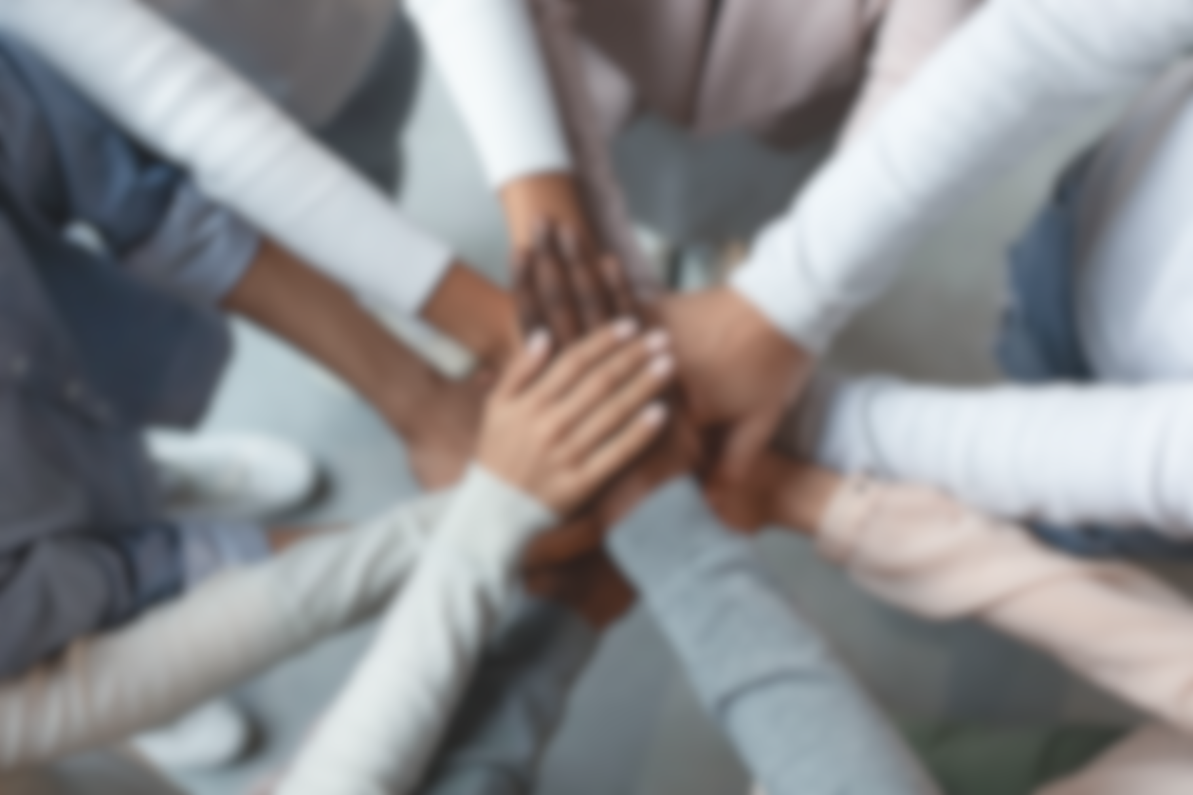
1+1=3
Person +person = more output
Samenwerken

Slide 7
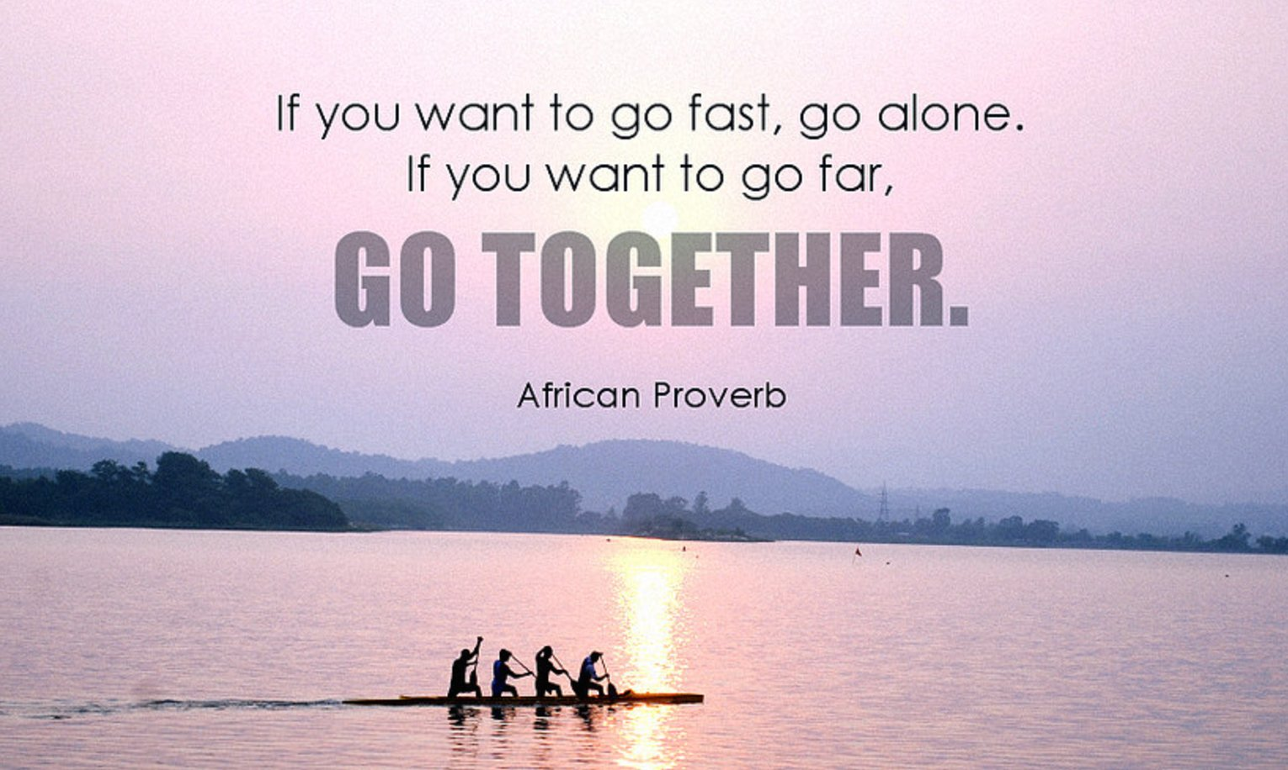
Collaboration
ECO teams werken samen aan 1 product, TopGun is geboren door de behoeft aan meer samenwerking

Slide 8
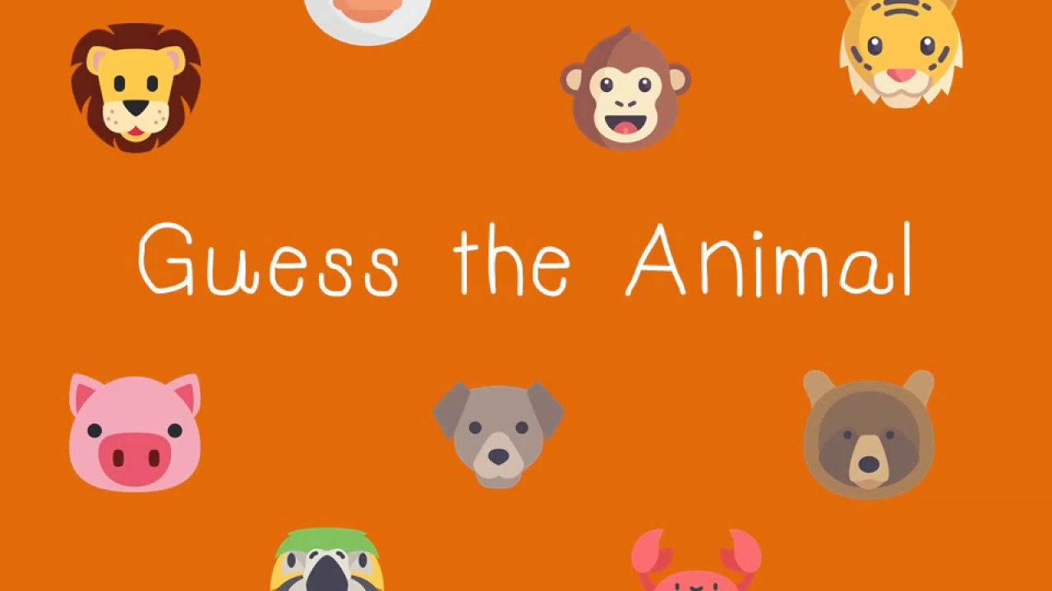


?

Slide 9
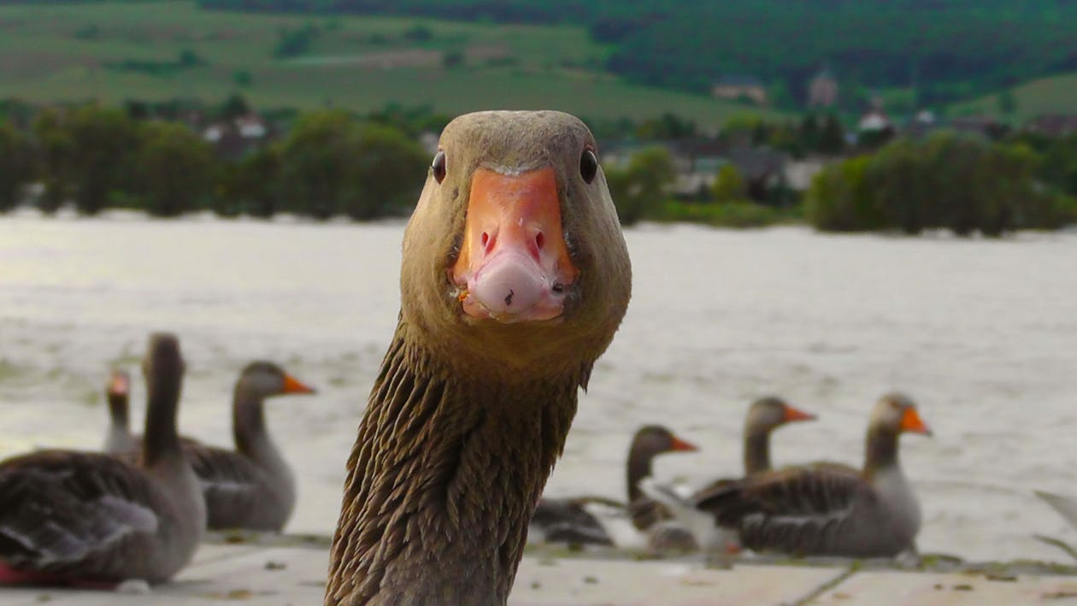

Slide 10
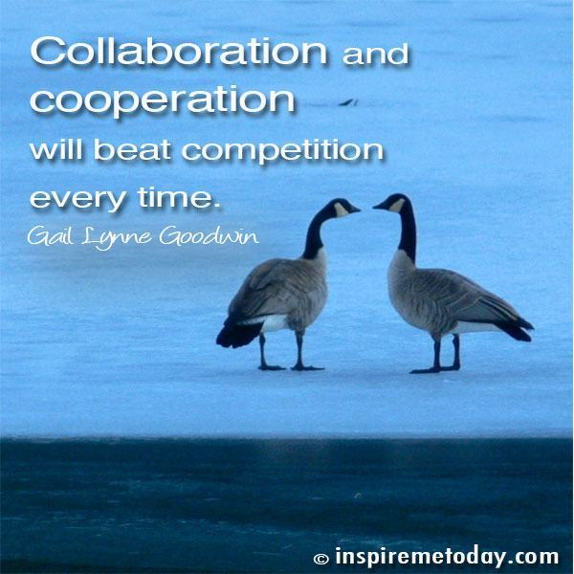



Slide 11
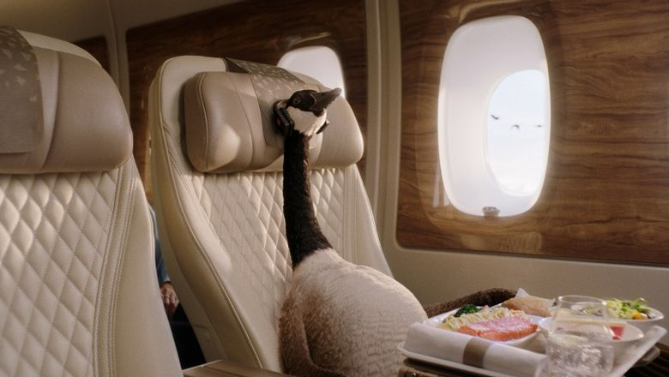

Slide 12
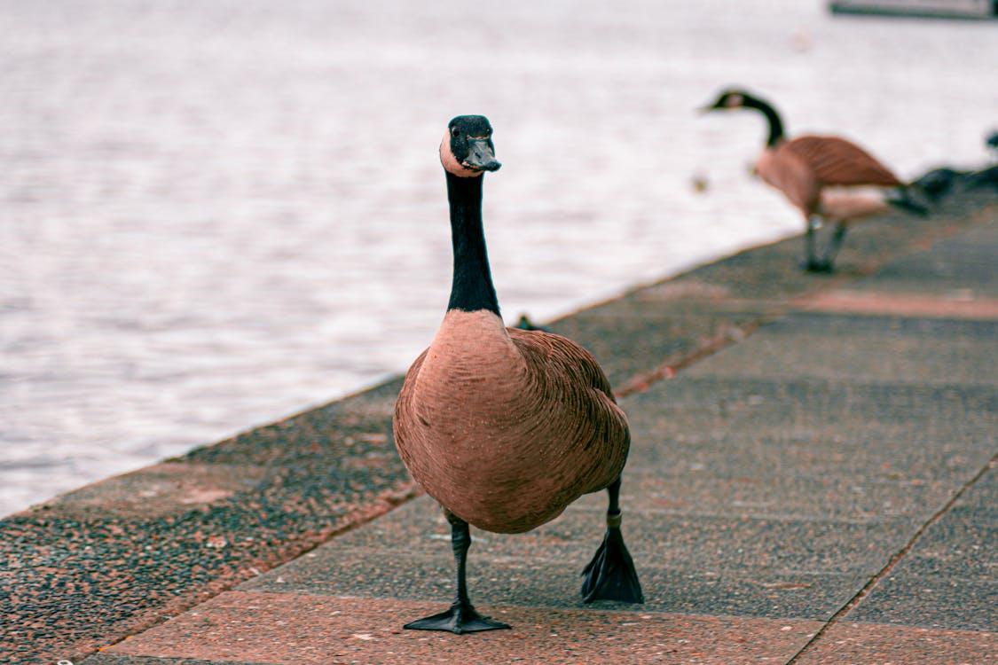

Slide 13
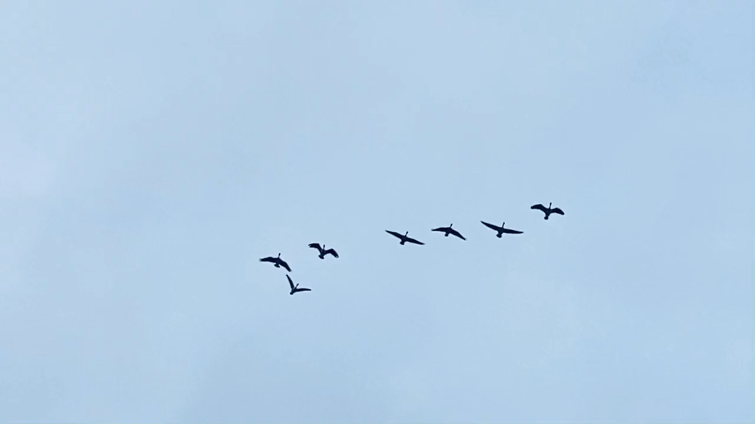

Slide 14
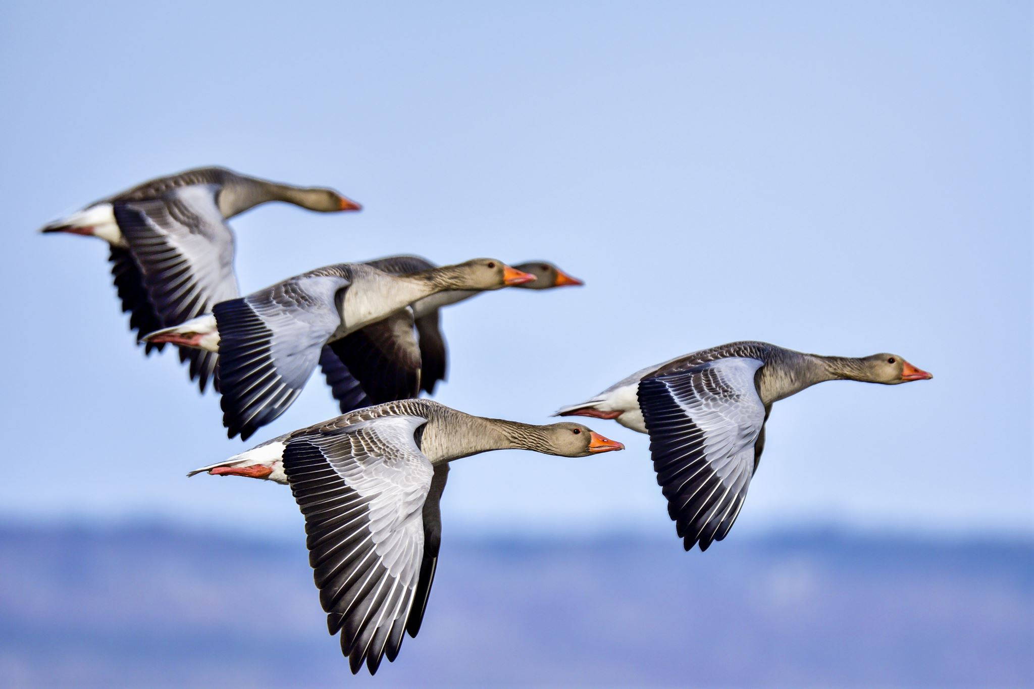

Slide 15
Wat kunnen we leren van ganzen?

Slide 16
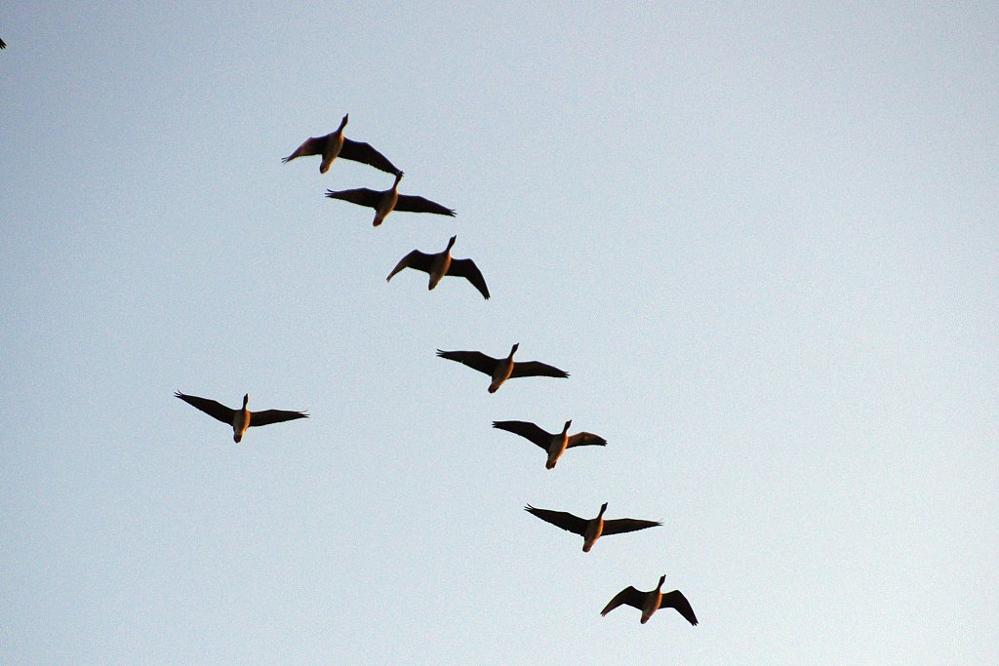
After losing formation, they quickly fly back as they fel the drag
Notes:
After losing formation, they quickly fly back as they feel the drag

Slide 17
After losing formation, they quickly fly back as they fel the drag
Notes:
After losing formation, they quickly fly back as they feel the drag

Slide 18
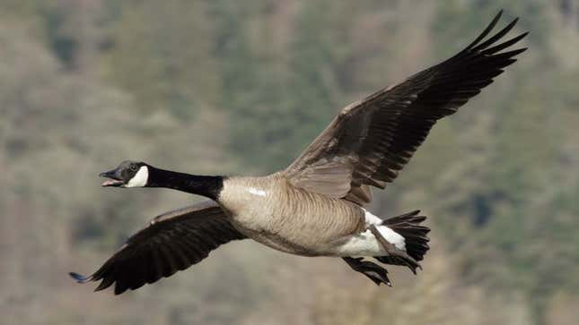

Notes:
Honk to encourage each other

Slide 19

Notes:
Honk to encourage each other

Slide 20
Notes:
Honk to encourage each other

Slide 21
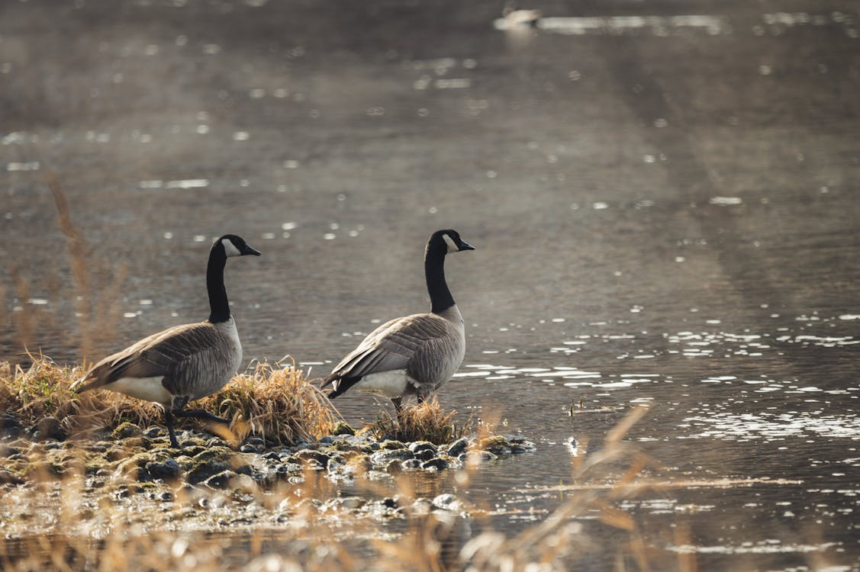
When 1 gets sick, 2 others stand by them

Slide 22
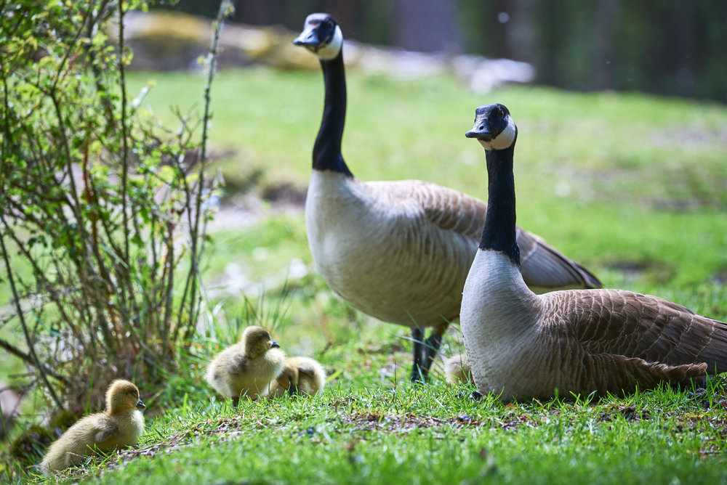

Slide 23
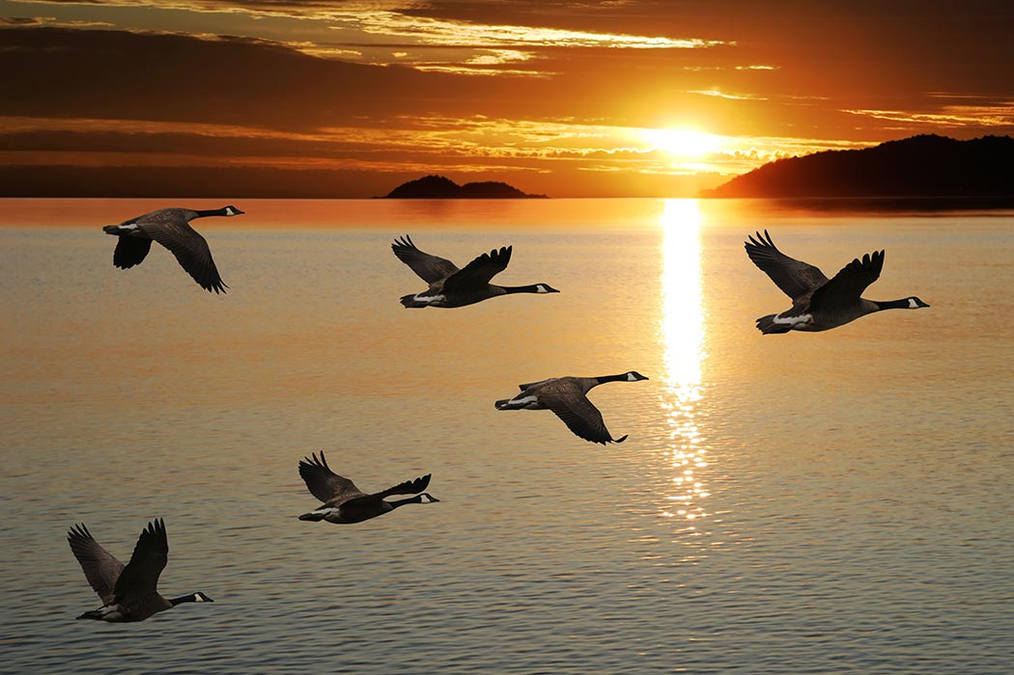
Notes:
What can we learn from geese

Slide 24

Beweeg in dezelfde richting
Moedig elkaar aan
Help elkaar

Slide 25
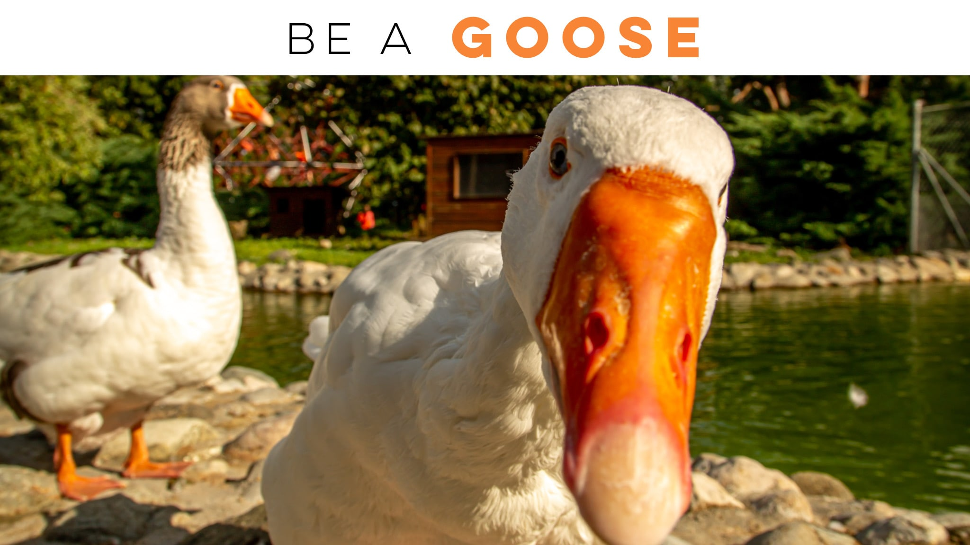

Slide 26
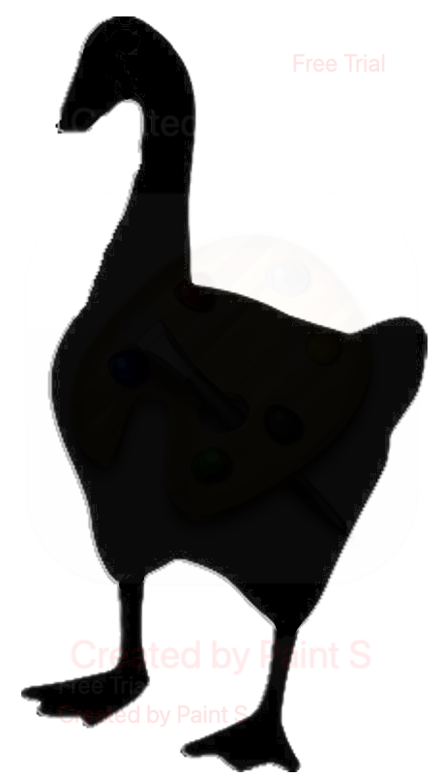
MIB42
Hero
Classified
TopGun
Doorontwikkeling
Ketenbeheer
Beheer team DigiD
Beheer team Machtigen
App team
Informatiebeveiliging
Design team
Service management
Migratie team
: (

Slide 27
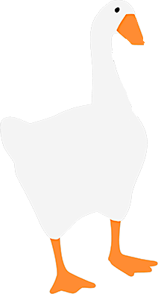

MIB40Goose
Head goose
Goosified
TopGans
DoorHonkwikkeling
V-formation
Nestbeheer team
Beheer team Machtigans
Ei team
Informatiebevlieging
Vleugeldesign
Service flock
Migratie team

Slide 28
